Slide 1
Recitation 4: Makefiles
CS 0449: Introduction to Systems Software
Griffin Hurt
Griffin Hurt
Undergraduate Teaching Fellow
griffhurt@pitt.edu
https://griffinhurt.com
Spring 2024, Term 2244
Friday 2 PM Recitation
Feb 9th, 2024
Slides adapted from
Shinwoo Kim, Martha Dixon, and Vinicius Petrucci
Department of Computer Science
School of Computing & Information
University of Pittsburgh
Course News
Agenda
Makefiles
Quiz!

Slide 2
Course News
Project 1 is out, due February 19th at 5:59PM
Recommend starting early!
Happy to help in office hours

Slide 3
Agenda
Makefile
No submissions
Quiz
Gradescope → Q1: C quiz
It’s timed

Slide 4
Makefiles
Automating and Optimizing Builds

Slide 5
Why and goal
Multiple files can be compiled independently and then merged together in a process called linking.
Generally, these two phases use different tools behind the scenes.
Project 1.
Write a Makefile to compile multiple files.

Slide 6
A Brief Overview Of Makefiles
What is make?
The make utility is a software tool for managing and maintaining computer programs consisting many component files. The make utility automatically determines which pieces of a large program need to be recompiled, and issues commands to recompile them
Make reads its instruction from Makefile (called the descriptor file) by default.
Makefile is a way of automating software building procedure and other complex tasks with dependencies.
Makefile contains: dependency rules, macros and suffix(or implicit) rules.
How does it work?
The relationships are described in a file named “Makefile” [by default]
You can name it differently, but it’s not current practice!
https://www.gnu.org/software/make/manual/make.html#Makefile-Names
Make will look into that file, and follow the rules described
Allows us to create custom settings and compile multiple files quickly with a single command (make)

Slide 7
Rules
Rules specifying how to make files
How to make a file is specified by a recipe
Target is the file created using the recipe
Targets have prerequisite files
Prerequisites can be made by another rule
Example Rule:
target: prerequisites
recipe
Target main depends on main.o (that is created by another rule) and it’s made by invoking gcc –o prog main.o
prog: main.o
gcc –o prog main.o
main.o: main.c
gcc –c main.c
Because the Makefile has a rule to generate main.o…
But you still need main.c

Slide 8
Example: without makefile
Compile this code:
gcc -c hellomake.c
gcc -o hellomake hellomake.o
int hellomake(){
return 0;
}
The “-c” argument to gcc will create a hellomake.o object file instead of link an entire executable.
We can now link the object file with the C standard library and create an executable called hellomake using this line.
https://www.cs.colby.edu/maxwell/courses/tutorials/maketutor/
Notes:
https://www.cs.colby.edu/maxwell/courses/tutorials/maketutor/

Slide 9
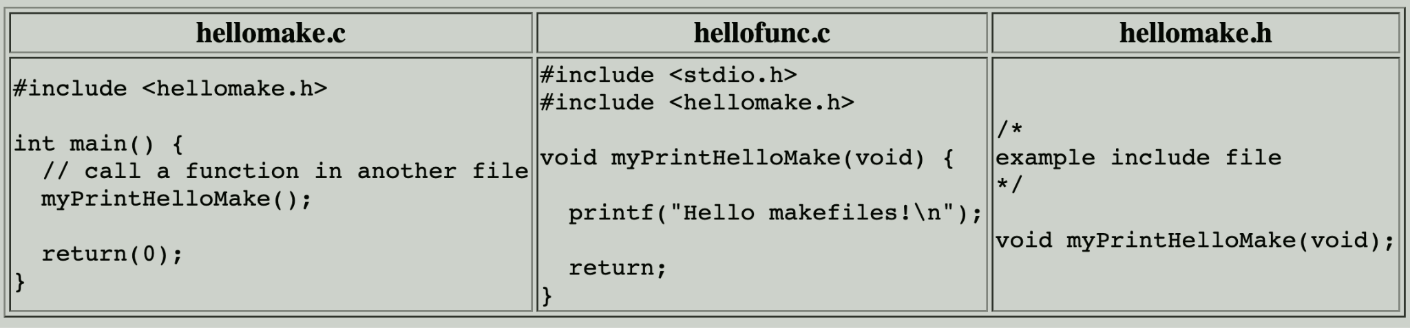
Example: without makefile
gcc -c hellomake.c
gcc -c hellofunc.c
gcc -o hellomake hellomake.o hellofunc.o
https://www.cs.colby.edu/maxwell/courses/tutorials/maketutor/

Slide 10
Example: with makefile
Makefile
hellomake: hellomake.o hellofunc.o
gcc -o hellomake hellomake.o hellofunc.o
hellomake.o: hellomake.c
gcc -c hellomake.c
hellofunc.o: hellfunc.c
gcc -c hellofunc.c
Hint: Indentation are strictly tabs.
https://www.cs.colby.edu/maxwell/courses/tutorials/maketutor/

Slide 11
More On MakeFiles
We can do a lot with MakeFiles, using custom rules and commands, variables, functions, conditional expressions, and more…
Read more about them on the course website
https://cs0449.gitlab.io/sp2023/resources/
Official documentation
https://www.gnu.org/software/make/manual/make.html

Slide 12
Quiz Time!
Password is: _________

